Slide 1



Digital portfolio
STUDENT NAME: Monisha.D
REGISTER NO: 24H315
NM ID:007E6F1FFD5A752B89F43DF97BDA6FCC
DEPARTMENT: BCA
COLLEGE/UNIVERSITY: Am jain college

Slide 2
AGENDA
1.Problem Statement
2.Project Overview
3.End Users
4. Tools and Technologies
5. Portfolio design and Layout
6. Features and Functionality
7.Results and Screenshots
8.Conclusion
9.Github Link
Notes:
2

Slide 3
Problem Statement
Many students lack a simple, professional way to showcase their skills, projects, and certificates in one place.

Slide 4
Project Overview
This project is a personal portfolio website built with HTML, CSS. It provides details about education, skills, certificates, and contact information.

Slide 5
End Users
• Recruiters
• Hiring Managers
• College Faculty
• Peers & Tech Community

Slide 6
Tools & Technologies
• HTML
• CSS
• JavaScript (optional future expansion)
• Email form
• Hosting platforms like GitHub Pages/Netlify

Slide 7
Portfolio Design & Layouts
• Clean and modern UI
• Navigation bar with smooth access
• Sections: About, Skills, Certificates, Contact
• Responsive grid layout for skills and certificates

Slide 8
Features & Functionality
• Personal information section
• Skills and certificates showcase
• Contact form (mail integration)
• Responsive design

Slide 9
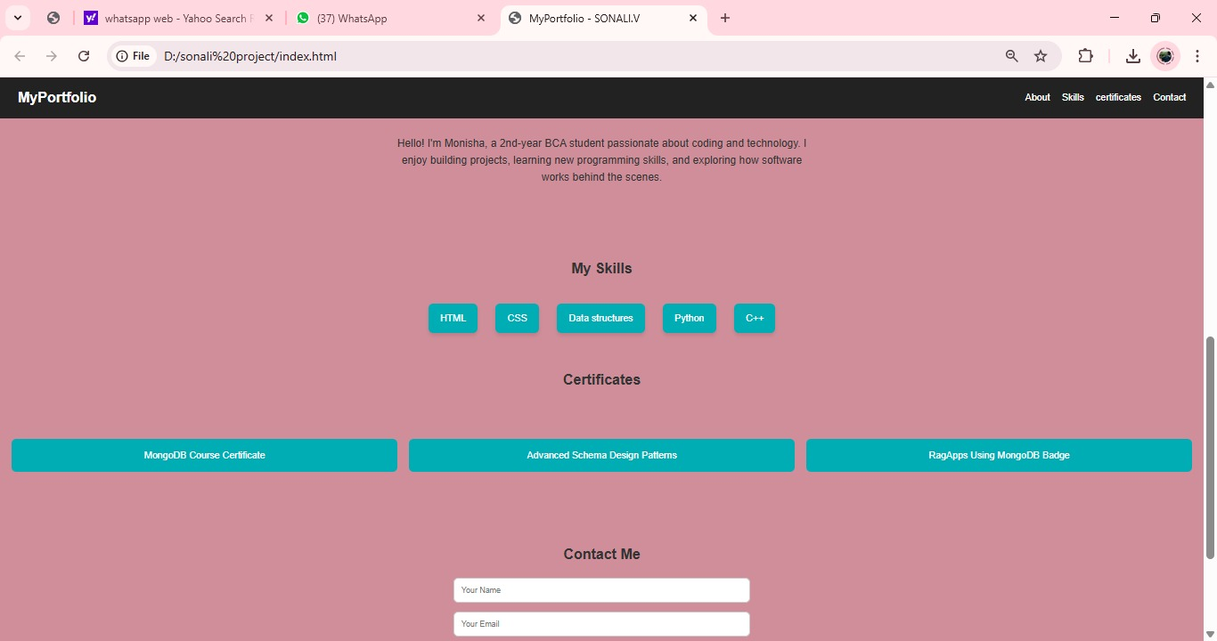
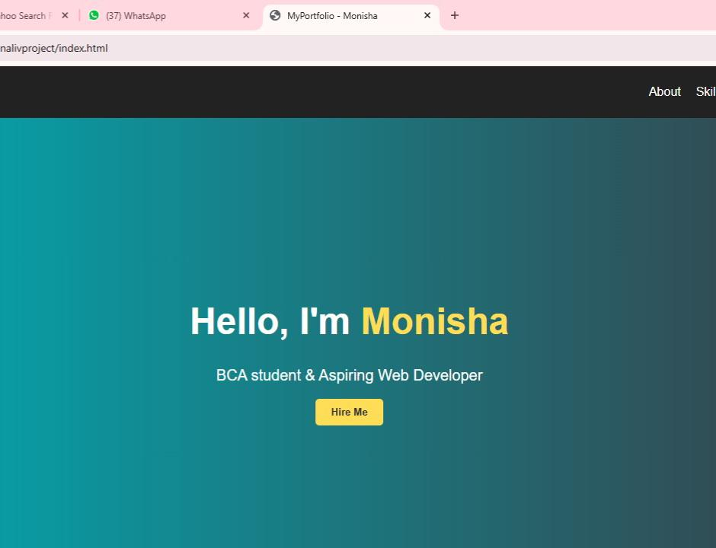
Results & Screenshots
The portfolio successfully demonstrates skills, certificates, and personal branding.
(Screenshots of webpage can be inserted here.)

Slide 10
Conclusion
This portfolio helps in personal branding and career opportunities. It acts as a digital resume and showcase of skills.

Slide 11
GitHub Link
GitHub Repository:https://24h315-spec.github.io/my-server/

